Slide 1

PACKAGING
BRAND MANAGEMENT SYSTEM
ADMIN MANUAL
Created by:- M. Nandeswar Rao
Date:- 03-09-18

Slide 2
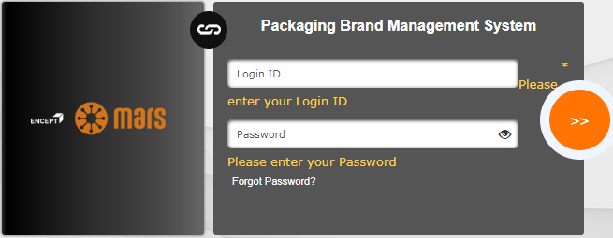

LOGIN TO THE APPLICATION
Enter the required URL In the browser tab and the following Login Screen will appear.
Please enter LOGIN ID and PASSWORD in respective fields.
You will get a reset link in your mail to reset the password, if you click Forgot Password. (Every time after adding new user in the user list, password need to be set using Forgot Password Link).
Click on login icon to login the application.

Slide 3

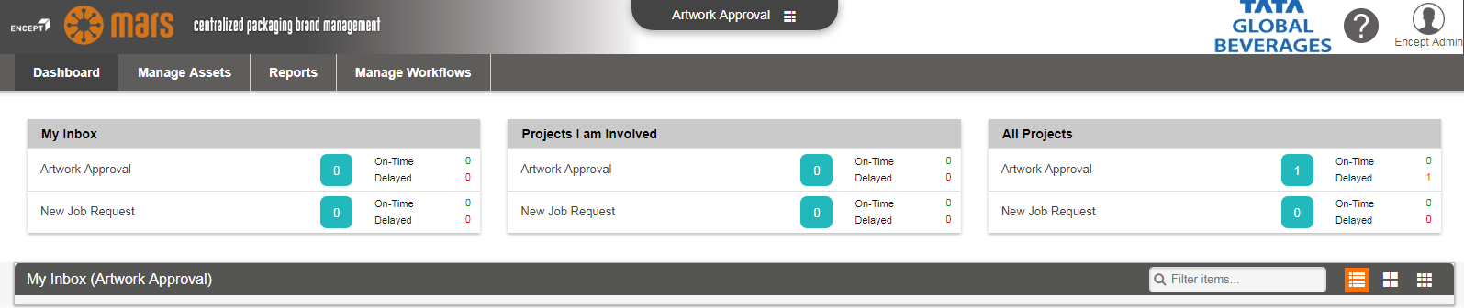
Once the user logged in below screen will appear.

Slide 4
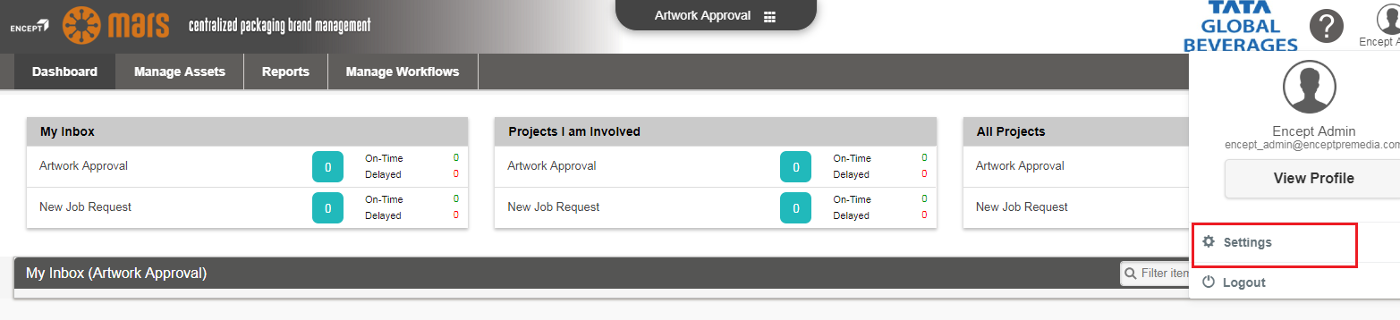
Click the user profile and then click the Settings link as shown below.

Slide 5
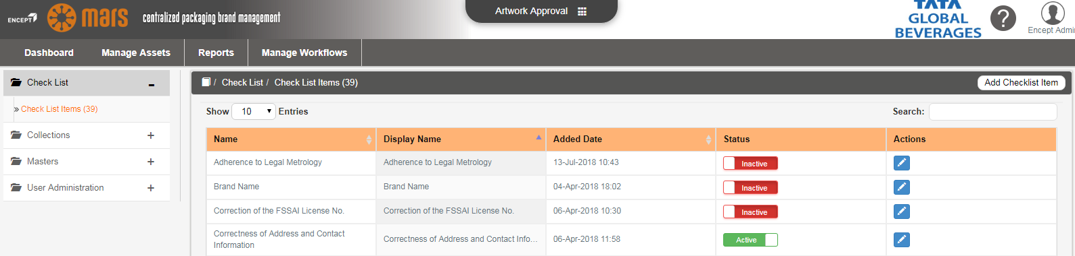
Once the user clicks Settings and the below shown Settings page appears.

Slide 6
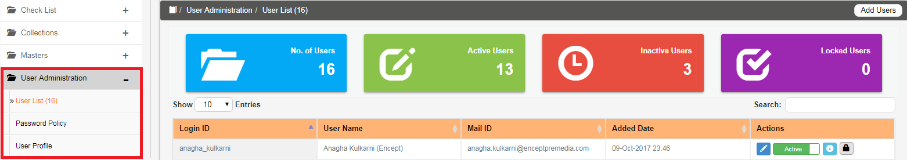
USER ADMINISTRATION
Click on the User Administration option you will see three option are available under User Administration.
(1) User List (2) Password Policy (3) User Profile

Slide 7
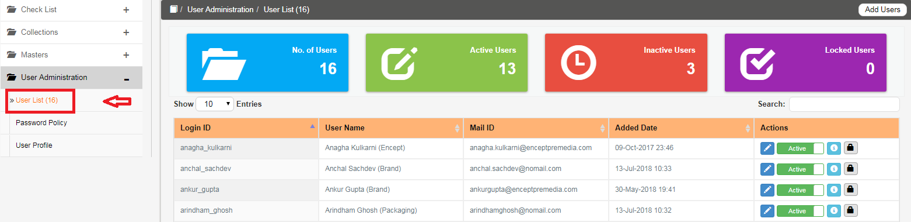
USER LIST
Click on the User List option shown below.

Slide 8
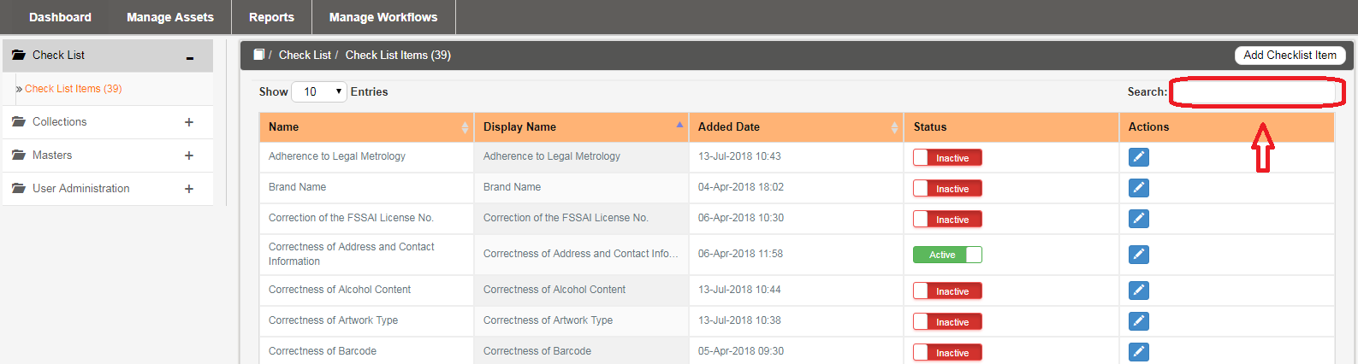
SEARCH
In the Search option User can search any user in the existing user list. If the user does not exists then he/she can Add the user mentioned below.

Slide 9
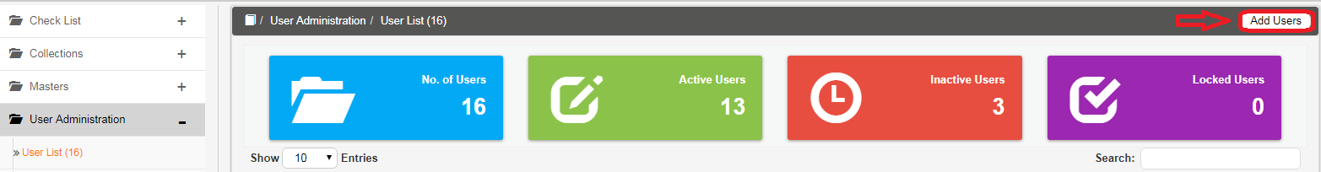
Features of User List
(1) ADD USER
User has the option to add new user to the existing list by doing the following steps.

Slide 10
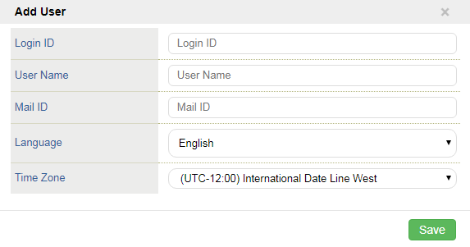
Once the user clicks the ADD USERS option a pop up screen appears below.
In the Add Users Screen
Enter the required Login ID. (Login ID should be unique).
Enter the required User Name.
Enter the Mail ID (Maid ID should be unique).
Select the appropriate language from the Language drop down list.
Select the appropriate Time Zone from the Time Zone drop down list.
Click on the Save button to save the added user.

Slide 11
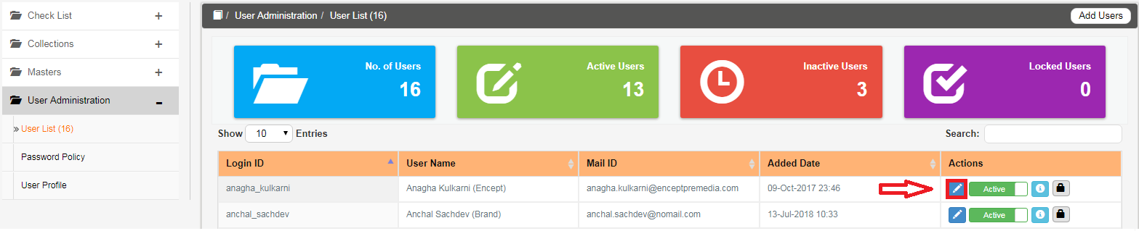
EDIT USER
User has the option to edit the existing user list for updations.
To edit do the following.
Click on the edit icon shown below.

Slide 12

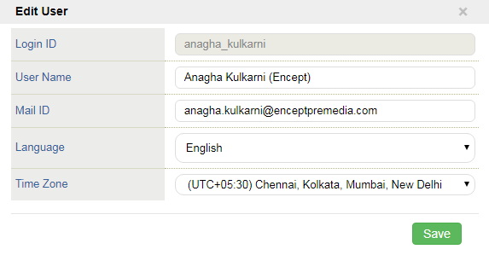
Once the user clicks the pop up appears as shown below.
In the Edit User Screen
User can edit User Name, Mail ID from the respective text boxes.
User can change the Language, Time Zone from the Language, Time Zone drop down list.
Click icon button to save the edited user details.

Slide 13
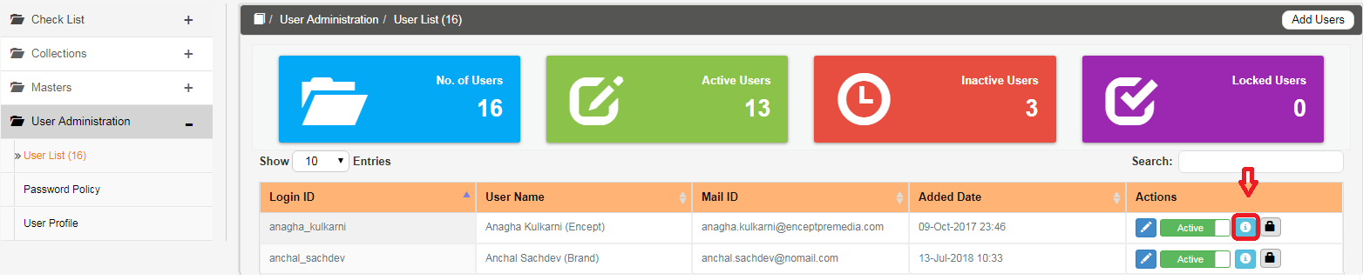
USER DETAILS
(1) Click this user details icon shown in the image shown below.
(2) After clicking User details icon a pop screen will appear shown below.

Slide 14
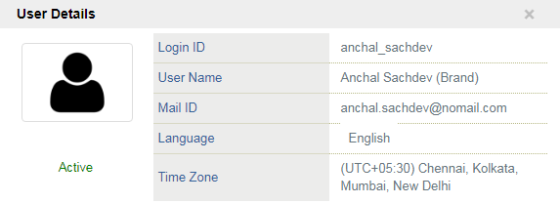
(3) On the User Details Screen,
User details like Login ID, User Name, Mail ID, Language, Time Zone will be displayed.
User can also view the user is Active or Inactive.

Slide 15
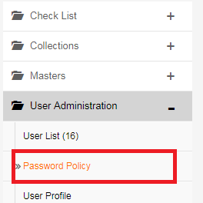
PASSWORD POLICY
Click on the Password Policy option available on the left side of the USER ADMINISTRATOR image shown below
After clicking the Password Policy option following screen will appear which is shown below.

Slide 16
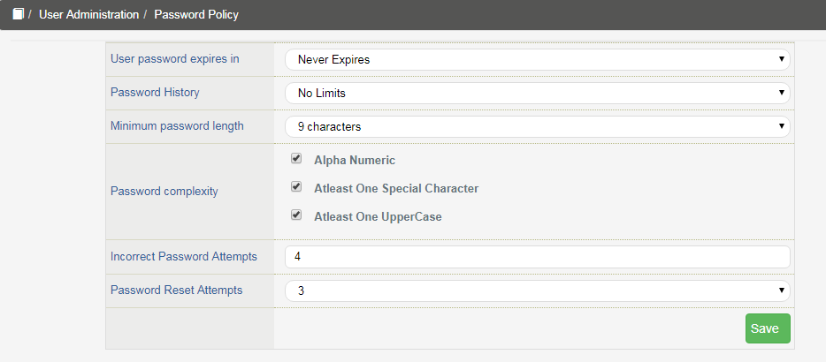
User Password expires: It should be Never Expires by default. If required User can change the Incorrect Password Attempts and Password Reset Attempts.

Slide 17
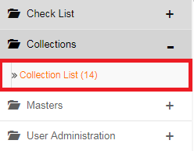
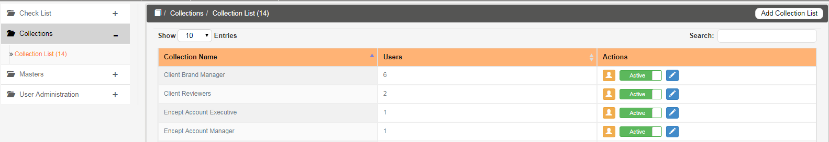
COLLECTIONS
1.Click on the Collection List option under the COLLECTIONS tab.
2.Once the Collection List is clicked, on the right hand side Collection List Screen will appear.

Slide 18
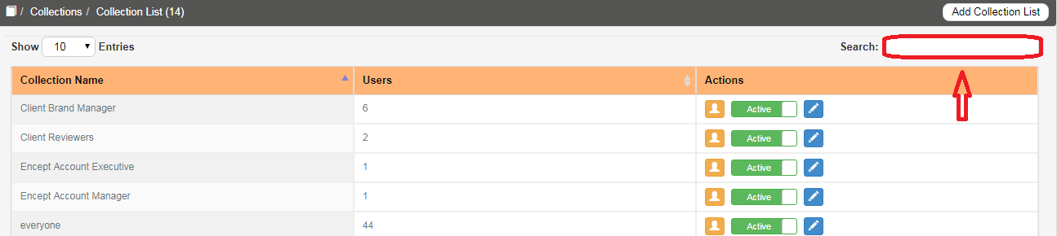
SEARCH
In the Search option User can search if Collection name is existing. If the Collection name does not exists then the user can Add the Collection name mentioned below.

Slide 19
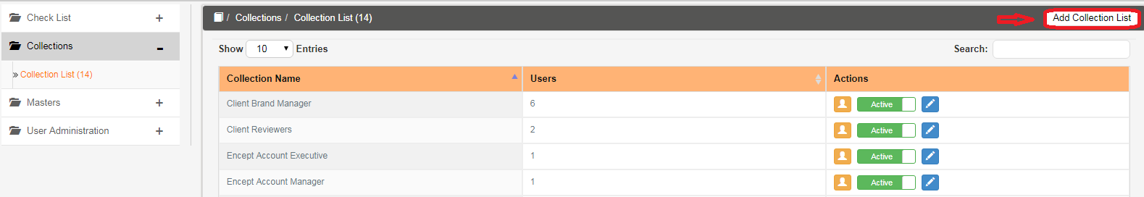
Add Collection List
To add collection list do the following.
3. Click on the Add Collections option which is shown below.

Slide 20
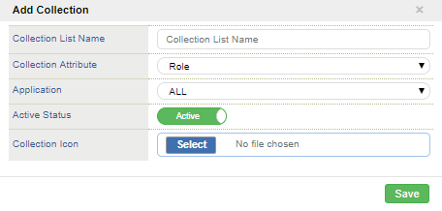
4. Once the user clicks Add Collection List option, a pop up screen will appear as shown below.
5. On the Add Screen,
  Enter the required Collection Name i.e Role Name in the Collection List Name text box.
  Select the required Collection Attribute from the Collection Attribute drop down as Role by default.

Slide 21
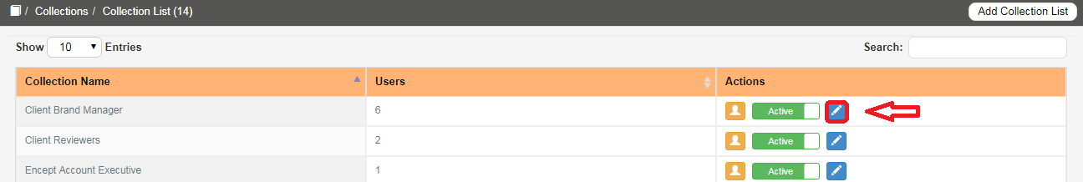
  Click the required Status in the Active Status drop down.
  Click Save to save the collection list details.
Edit Collection List
To edit do the following:
6. Click Edit icon to edit the Collection List in the image shown below.

Slide 22
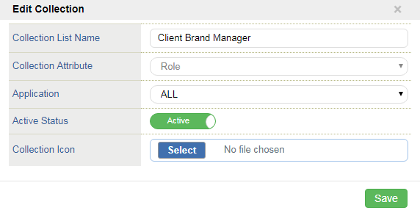
7.Once the Edit icon was clicked, the below shown pop up will appear,
8.On the Edit Screen
  User can edit the Collection List Name and Active Status.
  Click icon to save the edited Collection List.

Slide 23
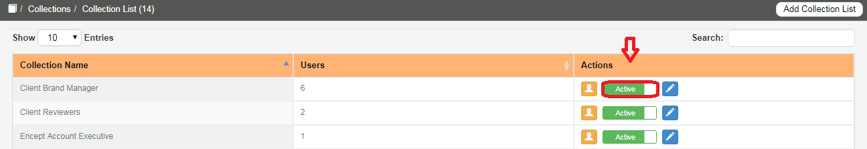
ACTIVE and INACTIVE
The User has to option to Active or Inactive the existing Users in the Collection List which will activate/inactivate the user in the application.
If the user needs to activate the Collections List, Click the status as Active.

Slide 24
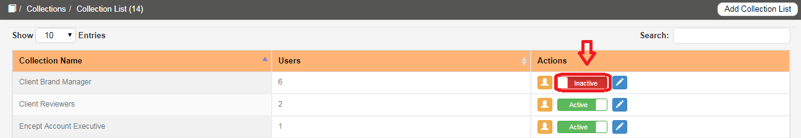
If the user needs to deactivate the Collections List, Click the Status as Inactive.
Add User:
To add user do the following
1. Click icon to add user to the collections.

Slide 25
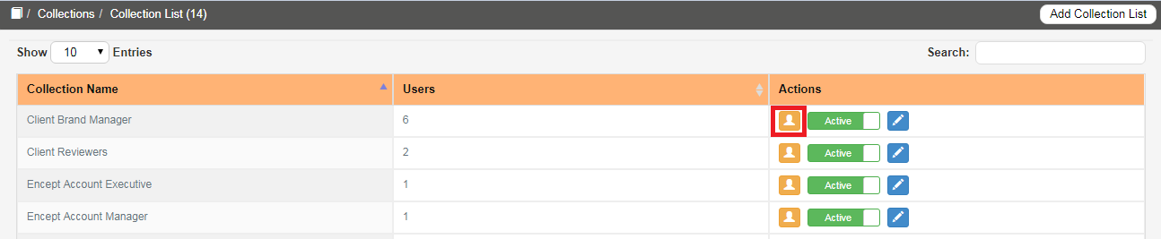
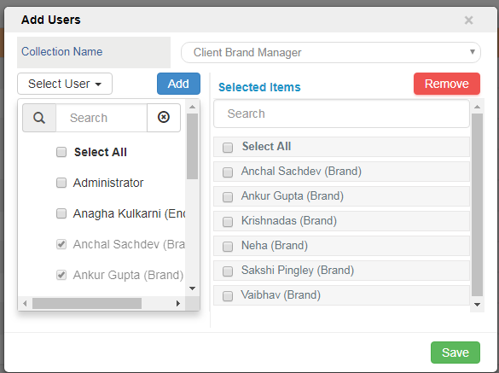
2.Once the user clicks the icon, the below shown pop up appears.

Slide 26
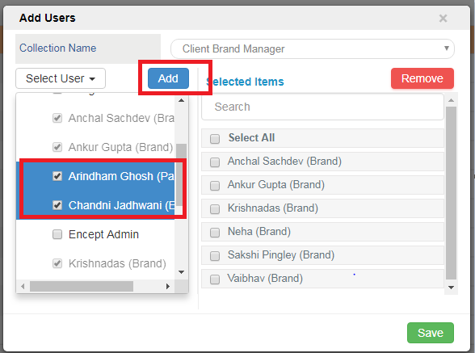
3.In the Add Screen,
  If the user needs to add the user, Select the required user and click Add button.

Slide 27
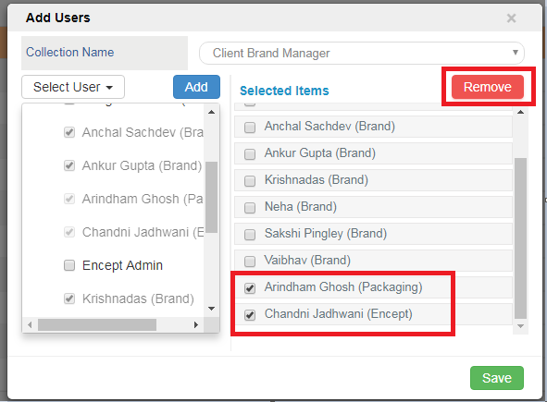
  If the user needs to remove the selected user, Select the required user from the selected items then click Remove button.
4. Click Save to save the Add user.

Slide 28
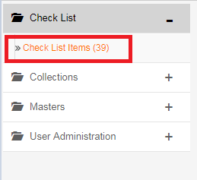
CHECKLIST
1.Click Check List Items under the Checklist.
2.Once the user clicks Checklist Items, on the right hand side checklist items will appear

Slide 29
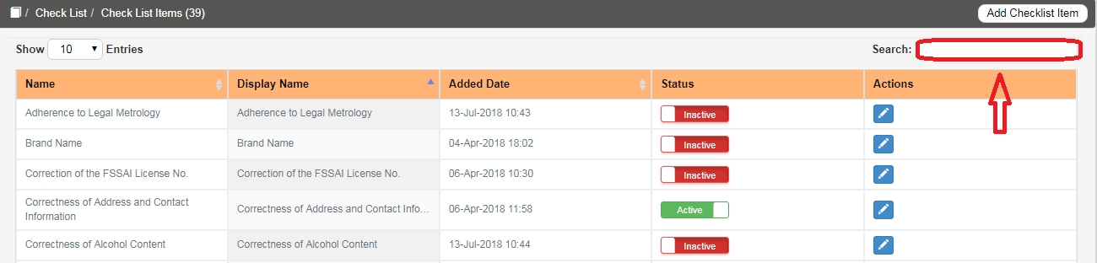
SEARCH
In the Search option User can search for the existing Check List Items name. If the Check List Items name does not exists then the user can Add the Check List Item to the Check List Items mentioned below.

Slide 30
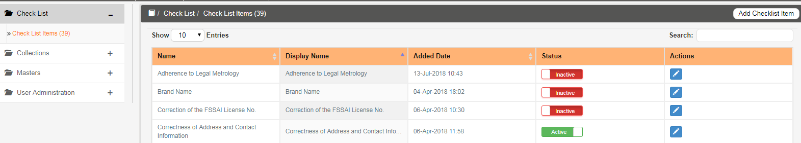
Add Check List Items:
To add do the following:
3.Click Add Checklist Items to add new checklist items.

Slide 31
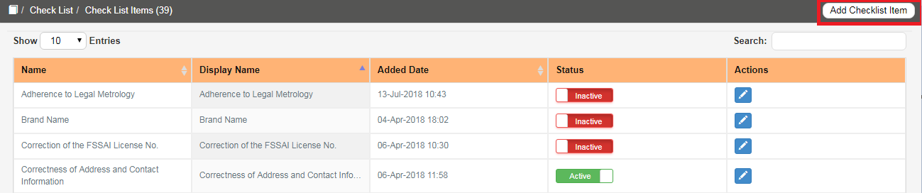
4.Once the Add button is clicked and the below shown pop up will appear,

Slide 32
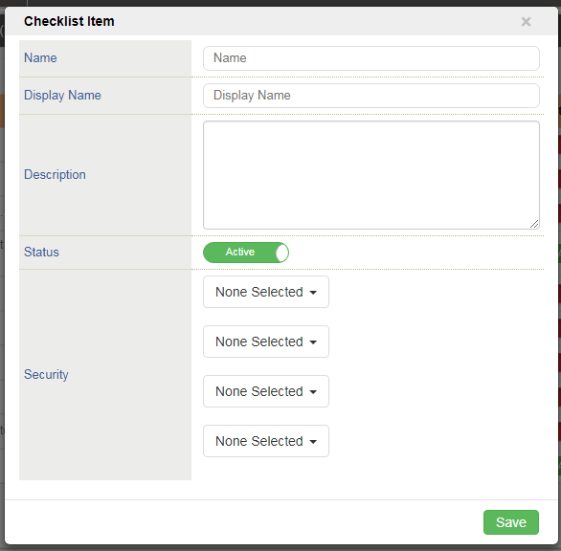
5.On the Checklist Item Screen,
  Enter the required Checklist Name in the Name text box.
  Enter the required Display Name in the Display Name text box.
  Enter the required Description in the Description text box.

Slide 33
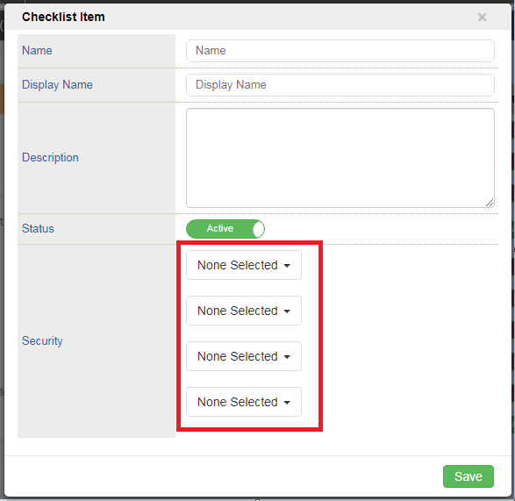
Select the required Status to activate/inactivate checklist item.
Select the required role from the Security drop down.

Slide 34
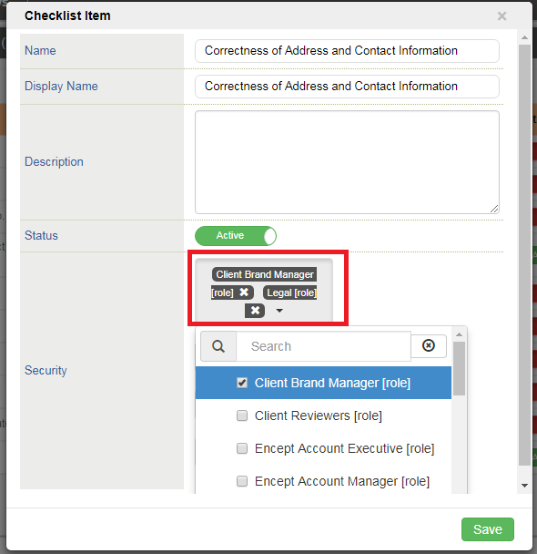
More than one role can be added by selecting from look up list as shown below,

Slide 35
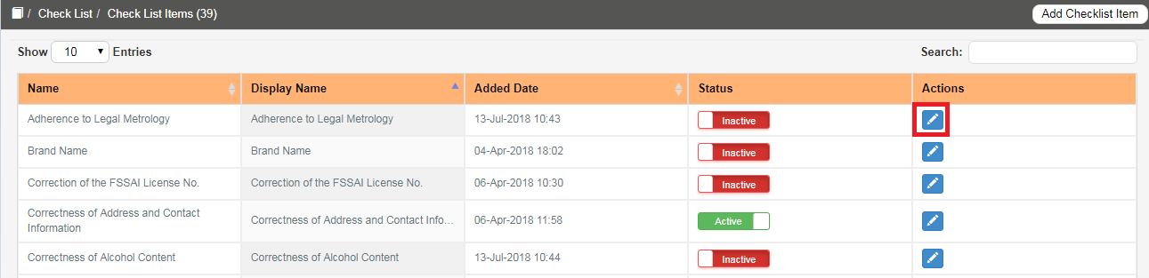
User can remove the selected role by deselecting from drop down list.
6.Click Save to Save the Checklist Items.
Edit Checklist Items
To Edit do the following:
7.Click Edit icon to edit the Checklist items.

Slide 36
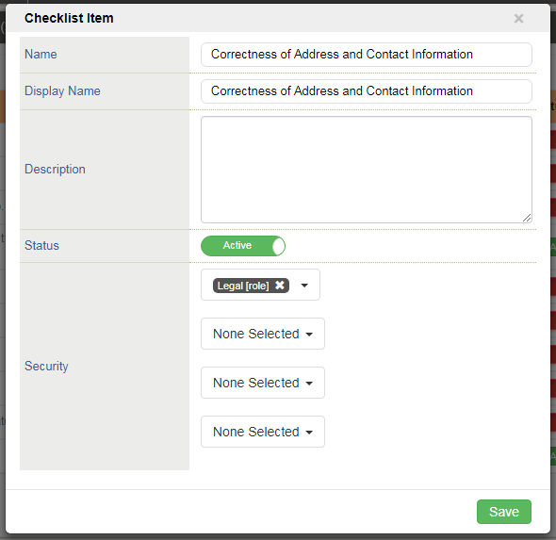
8.Once the edit icon is clicked and the below shown pop up will appear,
9.On the Checklist Items screen,
  User can edit or change the checklist items details (Name, Display Name)
  User can reselect Users from the Security dropdown.
  Click Save to save the edited Checklist Item.

Slide 37
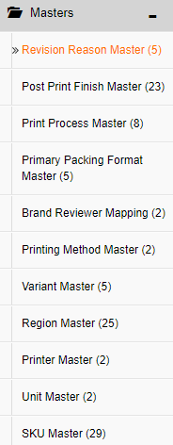
MASTERS
1.Click on the MASTERS menu option
2.It consists of 11 Masters such as :-

Slide 38
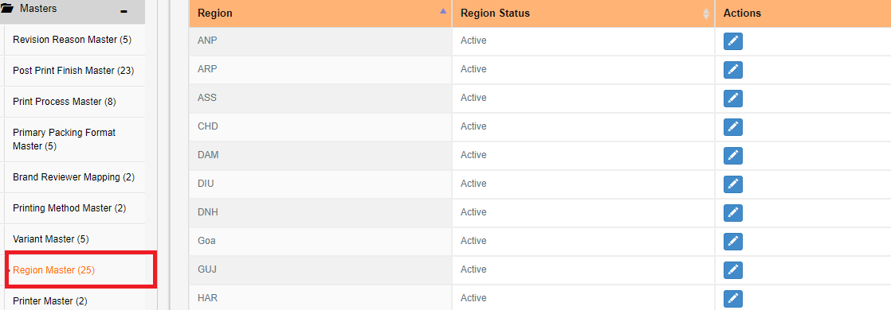
REGION MASTER
1.On the Left side of the navigation panel, Click REGION MASTER under the MASTERS.

Slide 39
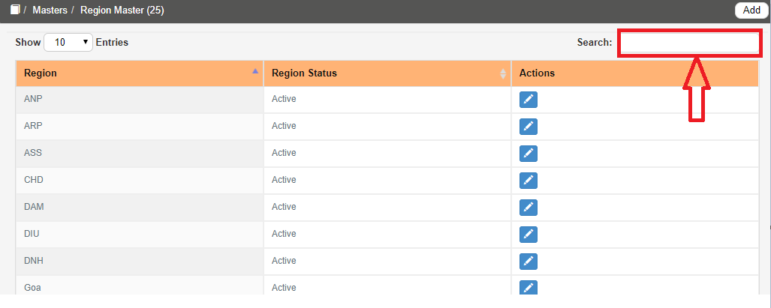
SEARCH
In the Search option User can search in the existing Masters Data. If the Master Data does not exists then the user can Add new Masters Data mentioned below.

Slide 40
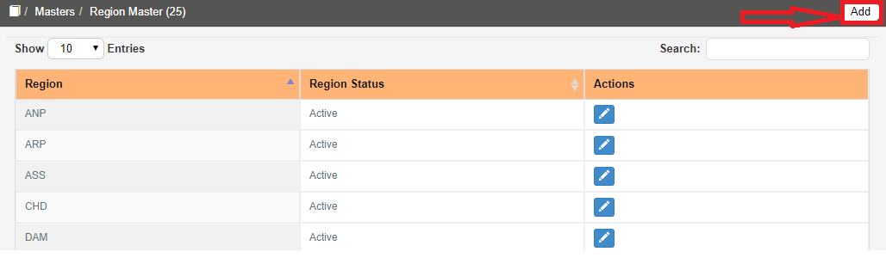
To add REGION Master, do the following,
2.Click icon shown below.

Slide 41
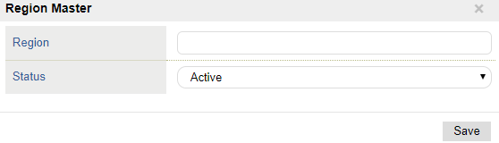
3.Once the user clicks the icon, a pop up screen appears as shown below.
4.On the Region Master Screen.
  Enter the required Region Name. (Region Name should be unique)
  Enter the required Status Active and Inactive option available in the Status
  Click on the Save button to save Region details

Slide 42
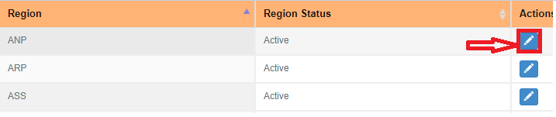
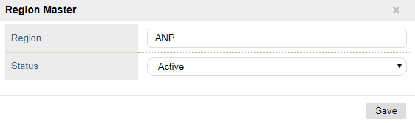
To Edit do the following :-
5.Click Edit icon shown below in red colour to edit the REGION MASTER details.
6.Once the user clicks the edit icon a pop up appears as shown below.
7.User can change the details in the Region Master
8.Click the Save Button to the save the details

Slide 43
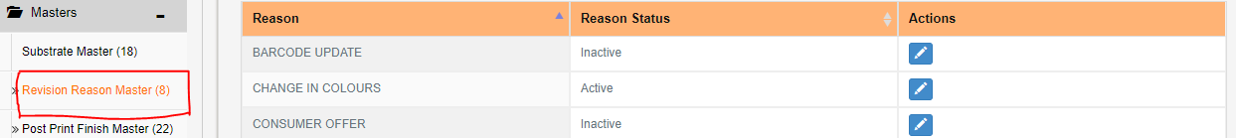
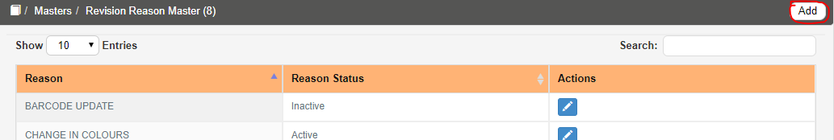
Revision Reason Master
1.On the Left side of the navigation panel, Click Revision Reason Master under the MASTERS
To add Revision Reason Master , do the following,
2.Click on Add to add a new Revision Reason Master .

Slide 44
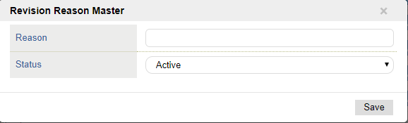
3.Once the user clicks the Add Icon a pop up appears as shown below
4.On the Revision Reason Master Screen.
  Enter the Reason field.(Reason should be Unique).
  Enter the Required Status Active and Inactive option are available in the Status.
  Click Save button to save Revision Reason Master details.

Slide 45
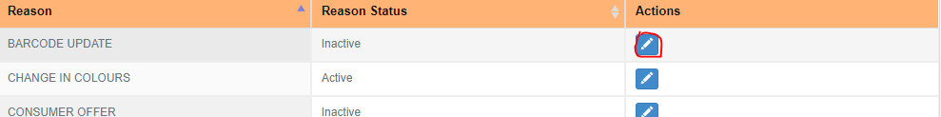
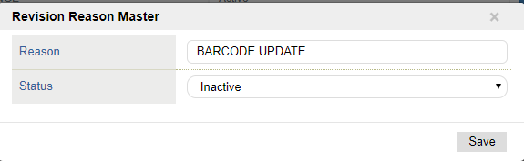
To Edit do the following,
5.Click Edit icon shown below to edit the Revision Reason Master details.
6.Once the user clicks the edit icon a pop up appears as shown below.
7.In the Revision Reason screen,
  User can change the Reason details from the Revision Reason Master.
  Click Save to save the Reason details.

Slide 46
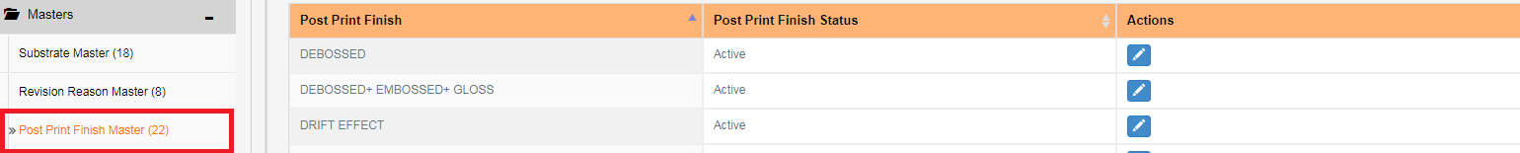

POST PRINT FINISH MASTER
1.On the Left side of the navigation panel, Click Post Print Finish under the MASTERS.
To add Post Print Finish, do the following,
2.Click on Add to add a new Post Print Finish.

Slide 47

3.Once the user clicks the Add Icon a pop up appears as shown below.
4.On the Post Print Finish Master Screen.
  Enter the Post Print Finish Name.(Post Print Name should be Unique).
  Enter the Required Status Active and Inactive option are available in the Status.
  Click Save button to save Post Print Finish details.

Slide 48


To Edit do the following,
5.Click Edit icon shown below to edit the Post Print Finish Master details.
6.Once the user clicks the edit icon a pop up appears as shown below.

Slide 49

7.In the Post Print Finish screen,
  User can change the Post Print Finish details from the Post Print Finish Master.
  Click Save to save the Post Print Finish details.
PRINT PROCESS MASTER
1.On the Left side of the navigation panel, Click Print Process Master under the Masters.

Slide 50


2.Once Print Process Master is clicked, On the right hand side Print Process Master screen will appear.
To add Print process Master do the following,
3.Click on Add to add a new Print Process Master.

Slide 51

4.Once the user clicks the Add, the pop up appears as shown below,
5.On the Print process Master Screen.
  Enter the Print Process Name. (Print Process value should be unique)
  Select the Required Status Active and Inactive option are available in the Status.
  Click Save button to save Print process Master details.

Slide 52


To edit do the following,
6.Click Edit icon to edit the Print process Master.
7.Once the user clicks the icon, the pop up appears as shown below,

Slide 53

8.In the Print Process Master screen,
  User can change the Print Process and Status from the respective text box.
  Click Save to save the Print Process details.
PRIMARY PACKING FORMAT MASTER
1.On the Left side of the navigation panel, Click Primary Packing Format Master under the Masters.

Slide 54


2.Once Primary Packing Format Master is clicked, On the right hand side Primary Packing Format Master screen will appear.
To add Primary Packing Format Master do the following,
3.Click on Add to add a new Primary Packing Format Master.

Slide 55

4.Once the user clicks the Add, the pop up appears as shown below
5.On the Primary Packing Format Master Screen.
  Enter the Primary Packing Format Name.(Should be Unique)
  Select the Required Status Active and Inactive option are available in the Status.
  Add Substrate name based on unique primary packing format.
  Click Save button to save Primary Packing Format Master details.
To edit do the following,
6.Click Edit icon to edit the Print process Master.

Slide 56


7.Once the user clicks the icon, the pop up appears as shown below,

Slide 57

8.In the Primary Packing Format Master screen,
  User can change the Primary Packing Format and Status from the respective text box.
  Click Save to save the Primary Packing Format details.
BRAND REVIEWER MAPPING MASTER
1.On the Left side of the navigation panel, Click Brand Reviewer Mapping Master under the Masters.

Slide 58


2.Once Brand Reviewer Mapping is clicked, On the right hand Brand
Reviewer Mapping Master screen will appear.
To add Brand Reviewer Mapping do the following,
3.Click on Add to add a new Brand Reviewer Mapping Master .

Slide 59

4.Once the user clicks the Add, the pop up appears as shown below,
5.On the Brand Reviewer Mapping Master Screen, added users are mapped under respective Role
  Enter the required Client Name in the Client Name text box.
  Enter the required Brand Name in the Brand Name text box. (Should be Unique)
  Select the required Participant from the Encept Account(Executive),Encept Account Manager(s),Client Brand Manager(s) and Client Reviewer(s) user list drop down. Multiple users can also be added from the drop down.

Slide 60

  Select the required status from the Status drop down.
  Click Save to save Brand Reviewer Mapping details.
To edit do the following,
6.Click Edit icon to edit the Print process Master.

Slide 61


7.Once the user clicks the edit icon, the pop up appears as shown below,

Slide 62

8.In the Brand PM Mapping screen,
  User can change the Client name, Brand Name, Encept Account(Executive),Encept Account Manager(s),Client Brand Manager(s) and Client Reviewer(s) Name from the respective drop down.
  Click Save to save the Brand Reviewer Mapping details.
PRINTING METHOD MASTER
1.On the Left side of the navigation panel, Click Printing Method Master under the Masters.

Slide 63


2.Once Printing Method Master is clicked, On the right hand Printing
Method Master screen will appear.
To add Printing Method Master do the following,
3.Click on Add to add a new Printing Method Master .

Slide 64

4.Once the user clicks the Add, the pop up appears as shown below,
5.On the Printing Method Master Screen.
  Enter the required Printing Method in the Printing Method text box. (Should be Unique).
  Select the required status from the Status drop down.
  Click Save to save Printing Method Master details.
To edit do the following,
6.Click Edit icon to edit the Printing Method Master.

Slide 65


7.Once the user clicks the edit icon, the pop up appears as shown below,
8.In the Printing Method Master screen,
  User can change the Printing Method and Status from the respective drop down.
  Click Save to save the Printing Method details.

Slide 66

VARIANT MASTER
1.On the Left side of the navigation panel, Click Variant Master under the Masters.
2.Once Variant Master is clicked, On the right hand Variant Master screen will appear.

Slide 67


To add Variant Master do the following,
3.Click on Add to add a new Variant Master .

Slide 68

4.Once the user clicks the Add, icon the pop up appears as shown below,
5.On the Variant Master Screen.
  Select the required Brand Name from the Brand Name drop down. (i.e. Brand Extension should be Unique and Variant Name should be Unique for same combination of Brand Name, Brand Extension).
  Enter the required Brand Extension in the Brand Extension text box.

Slide 69



6.On the Variant List,
  Enter the required Variant Name from Variant Name text box.
  If required user can add multiple Variant Name by clicking Add icon. Click Remove icon to remove the added Variant Name from the text box.
  Select the required status from the Status drop down.
  Click Save to save Variant Master details.
To edit do the following,
7.Click Edit icon to edit the Variant Master.

Slide 70

8.Once the user clicks the edit icon, the pop up appears as shown below,
9.In the Variant Master screen,
  User can change the Brand Name, Brand Extension, Variant list and Status from the respective drop down. (i.e. Brand Name, Brand Extension and Variant should be unique).
  Click Save to save the Variant details.

Slide 71

PRINTER MASTER
1.On the Left side of the navigation panel, Click Printer Master under the Masters.
2.Once Printer Master is clicked, On the right hand Printer Master, the screen will appear mention below.

Slide 72


To add Printer Master do the following,
3.Click on Add to add a new Printer.

Slide 73

4.Once the user clicks the Add, the pop up appears as shown below
5.On the Printer Master Screen.
  Enter the required Printer Name from the Printer Name text box.(Should be Unique)
  Enter the required Printer Location from the Printer Location text box.
  Enter the required Printer Mail Id from the Printer Mail Id text box.(Printer Name should be Unique).
  Select the required status from the Status drop down.
  Click Save to save Printer Master details.

Slide 74


To edit do the following,
6.Click Edit icon to edit the Printer Master.
7.Once the user clicks the edit icon, the pop up appears as shown below,

Slide 75
8.In the Printer Master screen,
  User can change the Printer Name, Printer Location, Printer Mail Id and Status from the respective drop down. (i.e. Printer Name and Printer Maid ID should be unique).
  Click Save to save the Printer details.

Slide 76

UNIT MASTER
1.On the Left side of the navigation panel, Click Unit Master under the Masters
2.Once Unit Master is clicked, On the right hand Unit Master screen will appear.

Slide 77

To add Unit Master do the following,
3.Click on Add to add a new Unit.

Slide 78


4.Once the user clicks the Add, the pop up appears as shown below,

Slide 79

5.On the Unit Master Screen.
  Enter the required Unit Name from the Unit Name text box. (Should be Unique)
  Select the required status from the Status drop down.
  Click Save to save Unit Master details.
To edit do the following,
6.Click Edit icon to edit the Printer Master.

Slide 80

7.Once the user clicks the edit icon, the pop up appears as shown below,
8.In the Unit Master screen,
  User can change the Unit Name and Status from the respective drop down.
  Click Save to save the Unit details. (i.e. Unit Name should be unique).

Slide 81

SKU MASTER
1.On the Left side of the navigation panel, Click SKU Master under the Masters
2.Once SKU Master is clicked, On the right hand SKU Master screen will appear.

Slide 82

To add SKU Master do the following,
3.Click on Add to add a new SKU Name.

Slide 83


4.Once the user clicks the Add, the pop up appears as shown below,

Slide 84



5.On the SKU Master Screen.
  Enter the required Brand Name, Brand Extension, Variant from the respective drop down. (i.e. For unique combination of Brand Name, Brand Extension and Variant, SKU Name & Unit should be unique).
6.On the SKU List,
  Enter the required SKU Name in the SKU Name text box. Select the SKU Unit from the SKU unit drop down.
  If required user can add multiple SKU Name and SKU Unit by clicking Add button .
  If not required user can remove the SKU Name and SKU Unit by clicking Remove button.
  Select the required status from the Status drop down.
  Click Save to save SKU Master details.
To edit do the following,
7.Click Edit icon to edit the SKU Master.

Slide 85


8.Once the user clicks the edit icon, the pop up appears as shown below,

Slide 86
9.In the SKU Master screen,
  User can change the Brand Name, Brand Extension, Variant, SKU, SKU Unit and Status from the respective drop down.
  Click Save to save the SKU details.

